Slide 1
IBM University Engagement Project Submission
“Exploring the Power of Agentic AI with IBM Granite and LangFlow”

Slide 2

Project Tile – Tracking Maternal Health Progress Toward SDG 3.1: A Global Data Analysis
Domain of Project – HealthCare - Problem Statements on ML by using AI_KOSH data sets
Student Name | Recent Passport Photo | Email ID | Mobile number [WhatsApp]
PRAVEEN S |  | p2452293@gmail.com | +91 8971864893
Aicte Id : STU66a0f37fe84ca1721824127

Slide 3
Problem Statement -
Problem Statement 36 — Tracking Maternal Health Progress Toward SDG 3.1
The Challenge
Maternal health datasets can be difficult to interpret and analyze because they typically contain:
Multiple indicators with different measurement units and time-period formats
Missing values, mixed numeric and categorical values, and large record counts
Multiple geographic dimensions across vast repositories
The Objective
                Users should not need advanced data-analysis knowledge just to understand:
              What the latest maternal mortality value is
              Whether progress is actively being made toward global targets
              How far the current data is from the Sustainable Development Goal (SDG) target
              Which healthcare and coverage indicators show critical gaps
            SDG 3.1 Target: Reduce the global maternal mortality ratio to less than 70 deaths per 100,000 live births by 2030.
Speaker Notes:
"Moving to Slide 2, our project is built around the IBM SkillsBuild and AICTE problem statement focusing on SDG 3.1—reducing the global maternal mortality ratio to below 70 per 100,000 live births by 2030. The core challenge we address is that public health data is massive, complex, and filled with mixed metrics. Stakeholders shouldn't need a data science background just to figure out if public health indicators are improving or where coverage gaps lie."

Slide 4
Proposed Solution
Proposed Solution: AI-Powered Maternal Health Analytics Platform :
The proposed solution is MaternaLens AI, an intelligent maternal-health analytics platform built using Streamlit, Python, and IBM watsonx.ai to provide automated data interpretation and actionable insights for tracking SDG 3.1 progress. The system addresses challenges in interpreting complex public health datasets through a unified, intelligent architecture.
At its core, the solution uses a robust data pipeline and analytical engine to validate and process maternal health indicators from official sources, such as the Government of India SDG dataset. The system dynamically computes critical metrics—including Maternal Mortality Ratio (MMR) trends, SDG target gaps, and healthcare coverage discrepancies—before passing these structured calculations to an AI model for natural-language interpretation.
The system consists of integrated analytical and AI components:
Automated Data Validator: Ingests datasets, detects column aliases (e.g., location, time, indicators), and ensures data quality by checking for missing values and numeric viability.
Statistical Analysis Engine: Calculates MMR reductions and target gaps, while dynamically checking analytical readiness (e.g., intentionally disabling geographic correlation if only one location exists to avoid misleading statistics).
Visual Analytics Dashboard: A user-friendly interface built with Streamlit that visualizes metric distributions, MMR trends, data cubes, and analytical heatmaps.
AI Interpretation & Q&A Engine: Translates deterministic statistical calculations into natural-language insights and allows users to ask conversational questions about the dataset.
Python and Streamlit orchestrate the application workflow, while IBM watsonx.ai provides the cloud infrastructure for AI inference. The Meta Llama 3.3 70B Instruct model powers the contextual interpretation, ensuring that all AI outputs are strictly grounded in the derived data rather than raw dataset hallucinations.
Overall, MaternaLens AI delivers an end-to-end decision-support tool that transforms raw maternal-health data into understandable evidence, enabling researchers and policymakers to effectively track SDG 3.1 targets.

Slide 5
Technology Used
    Streamlit & Python – For designing and building the interactive, web-based analytical dashboard and user interface.
    Meta Llama 3.3 70B Instruct – Accessed via IBM watsonx.ai for natural language understanding, reasoning, interpreting statistical maternal health data, and powering the conversational Q&A feature. (Note: Granite models were explored, but Llama 3.3 70B was selected for optimal API inference compatibility in this environment.)
    IBM watsonx.ai & IBM Cloud – Provides the cloud infrastructure (Studio Lite plan, Sydney region) and Python SDK to securely connect to foundation models and run AI inferences.
    Pandas, NumPy & Scikit-learn – Forms the deterministic analytical engine used to load data, validate schemas, calculate MMR trends, and identify SDG target gaps before passing structured context to the AI.
    Plotly & Matplotlib – For generating dynamic visual analytics, including MMR trend lines, indicator distributions, and data cube heatmaps.
    VS Code, Jupyter & GitHub – Visual Studio Code and Python virtual environments were used for local development, Jupyter Notebooks for exploratory data analysis, and Git/GitHub for version control.

Slide 6
Langflow component Used
Natural-Language Q&A Input – An interactive chat interface where users can ask conversational questions about the maternal health dataset (e.g., "What is the latest MMR?" or "How much has MMR reduced?").
IBM watsonx.ai Integration – The AI engine that receives structured analytical context (such as calculated target gaps and metric reductions) to generate relevant, dataset-grounded interpretations.
Foundation Model (Meta Llama 3.3 70B Instruct) – The specific model utilized through the IBM watsonx.ai API for reliable natural-language reasoning and insight generation.
AI Insights Output – Displays a combination of deterministic analytical calculations and AI-generated text, clearly explaining maternal health metrics and progress toward the SDG 3.1 target.
Data Uploader & Validation Component – Handles the ingestion of both the built-in dataset (SDG-3-1-DATA-GOV.csv) and user-uploaded files, executing automated schema detection and checking for missing values.
Analytical Engine & Visual Dashboard – A Streamlit-based interface leveraging Pandas and Plotly to calculate MMR trends, coverage gaps, and render visual data cubes and heatmaps without requiring manual data inspection.

Slide 7
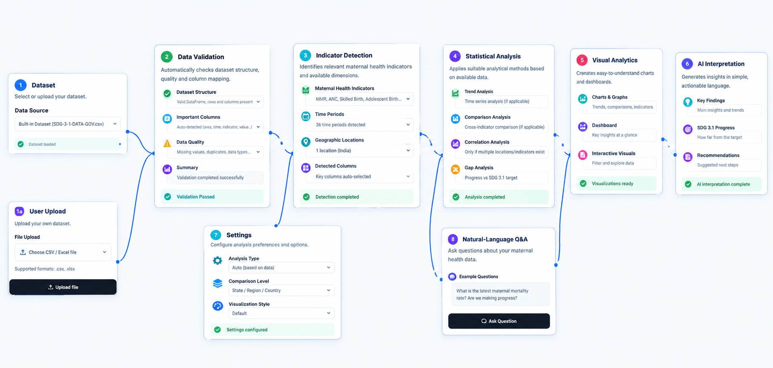
Langflow workflow -

Slide 8
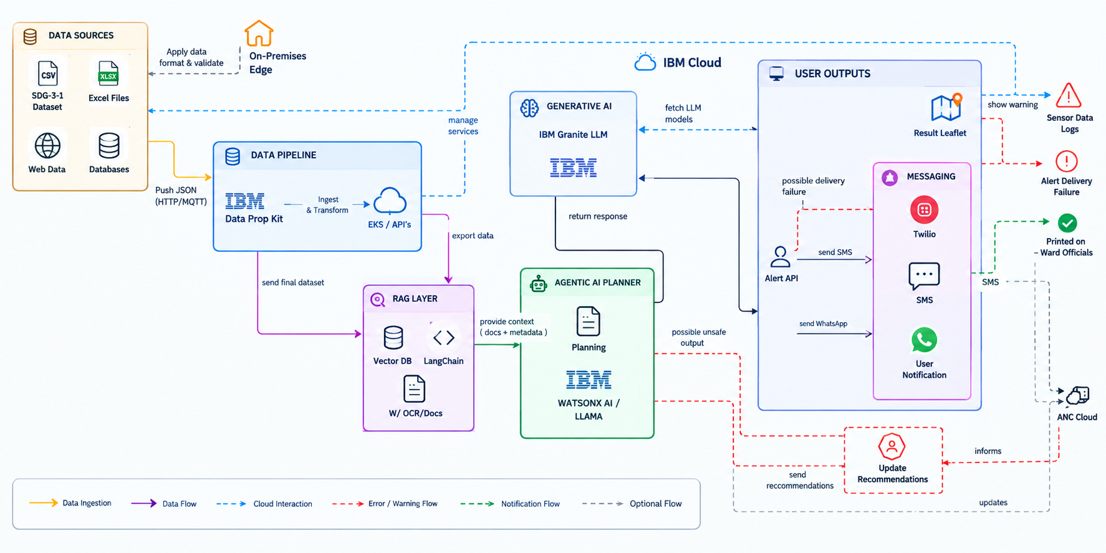
Architecture blueprint

Slide 9

Role of Agentic AI in the solution
Role of Agentic AI in MaternaLens AI
Agentic AI enables MaternaLens AI to function as an intelligent, data-driven system rather than a simple data visualization tool. Using IBM watsonx.ai and Meta Llama 3.3 70B Instruct, it combines automated data validation, analytical processing, visualization, AI interpretation, and natural-language Q&A to help users understand maternal-health data and track progress toward SDG 3.1.
Each component performs a specific role—such as loading datasets, validating data, detecting important columns and indicators, analyzing maternal mortality trends, calculating target gaps, analyzing coverage indicators, and generating visual insights. These components work together to provide a structured and efficient analytical workflow.
Agentic AI also brings context awareness by using structured information derived from the dataset, such as MMR values, the latest MMR, initial MMR, SDG target, target gap, reduction, coverage indicators, and dataset statistics. This information is provided to the AI model so that the generated insights remain grounded in the available dataset.
The system also supports adaptive analysis based on the characteristics of the uploaded dataset. It checks whether sufficient information is available before performing certain analytical methods. For example, correlation analysis is not applied when only one geographic location is available, preventing statistically misleading results.
Additionally, MaternaLens AI combines deterministic analytical calculations with AI-generated interpretation. Important factual questions can be handled through analytical logic, while broader questions can use IBM watsonx.ai to generate dataset-grounded responses through the natural-language Q&A feature.
Overall, Agentic AI makes MaternaLens AI intelligent, context-aware, adaptive, and goal-driven, transforming complex maternal-health datasets into understandable insights that help users track progress, identify gaps, and support SDG 3.1 decision-making.

Slide 10
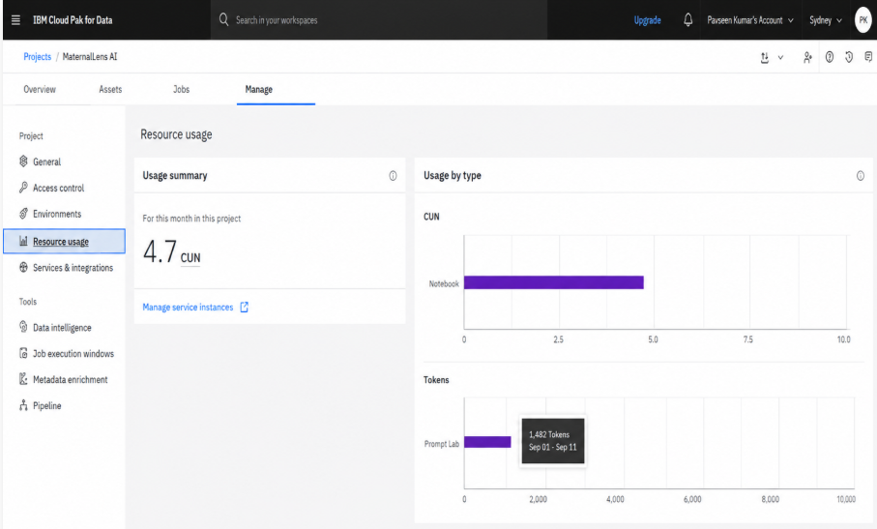
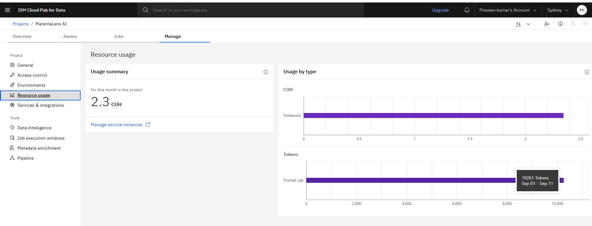
Token Usage
10,261 token are used
Before Prompt
After the Prompt
·
·
·

Slide 11
Novelty and Uniqueness
What Makes MaternaLens AI Stand Out
The proposed MaternaLens AI stands out by combining automated data validation, analytical intelligence, visualization, AI interpretation, and natural-language Q&A into a single maternal-health analytics platform.
Automated Data Validation – Validates datasets by checking structure, missing values, duplicate records, numeric-compatible values, important columns, and SDG 3.1-related information.
Intelligent Data Analysis – Automatically analyzes MMR trends, target gaps, maternal-health coverage indicators, distributions, and other analytical characteristics based on the available data.
Context-Aware AI Interpretation – Uses structured analytical information such as MMR values, target gaps, coverage indicators, and dataset statistics as context for generating relevant, dataset-grounded insights.
Analytical Readiness – Does not blindly apply statistical methods. The system checks whether the available dataset supports an analysis. For example, correlation is not applied when only one geographic location is available.
Interactive Visualization – Provides dashboards, MMR trend charts, target-progress visualizations, indicator comparisons, distributions, data cubes, and heatmaps to make complex datasets easier to understand.
Natural-Language Q&A – Allows users to ask questions such as the latest MMR, MMR reduction, SDG 3.1 target, number of records, and maternal-health coverage directly through the application.
IBM watsonx.ai Integration – Uses IBM watsonx.ai with Meta Llama 3.3 70B Instruct to generate dataset-grounded AI interpretations. The AI complements deterministic analytical calculations rather than replacing them.
Flexible Dataset Support – Supports both the built-in Government of India's SDG dataset and user-uploaded datasets, with the same validation, detection, analysis, visualization, and AI pipeline.
This makes MaternaLens AI an intelligent, analytical, and user-friendly platform that transforms raw maternal-health data → understanding → evidence → insight, helping users track progress and identify gaps related to SDG 3.1.

Slide 12
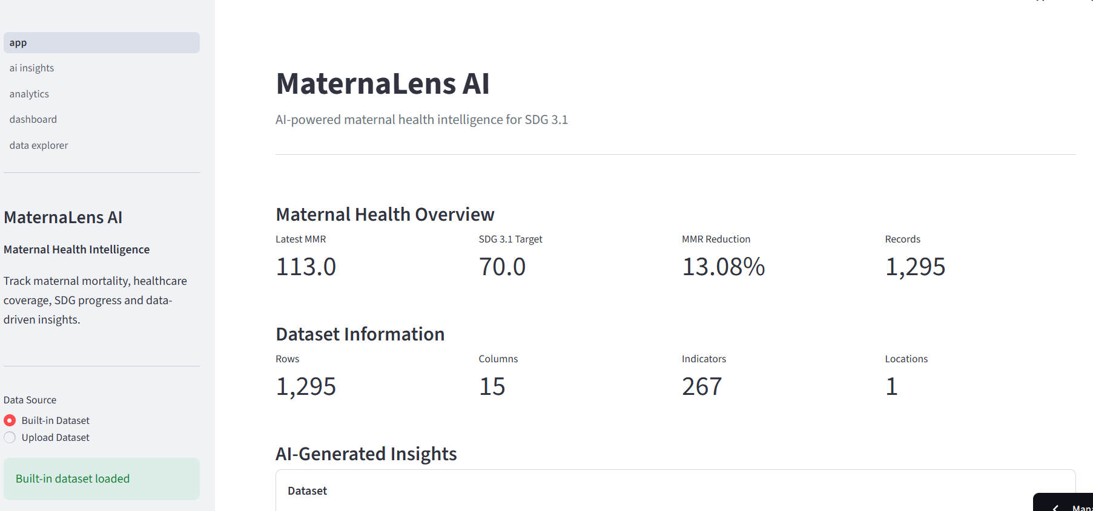
Main App Page
·
·
·

Slide 13
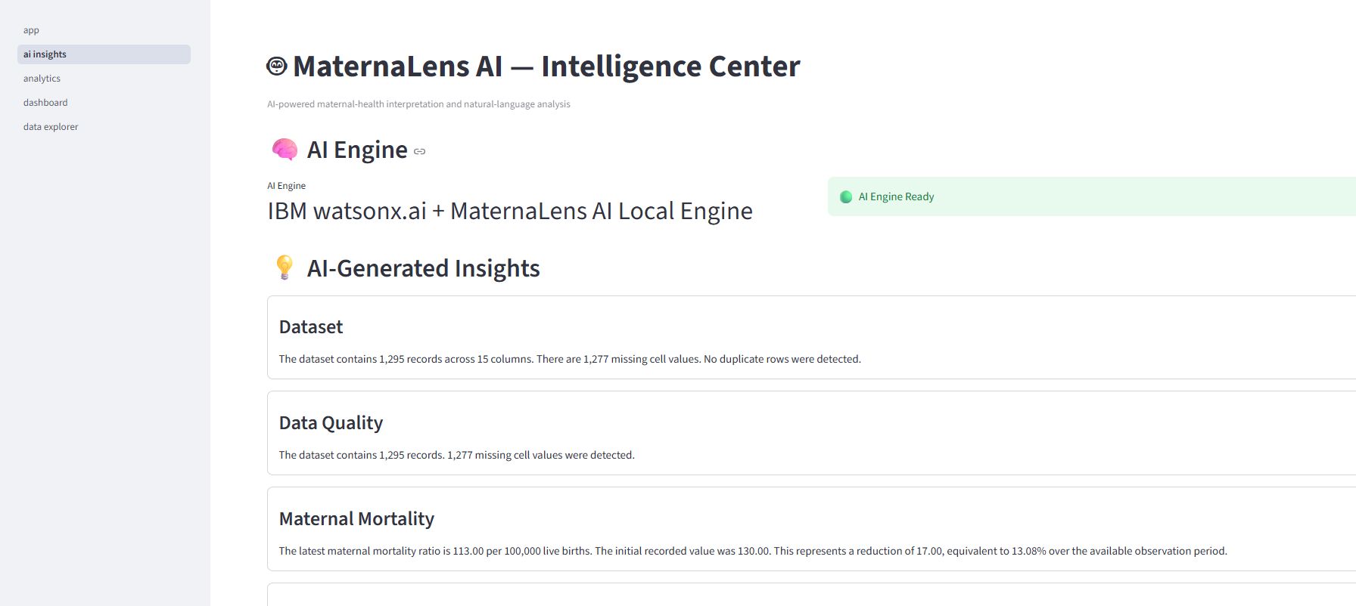
AI Insights Page
·
·
·

Slide 14
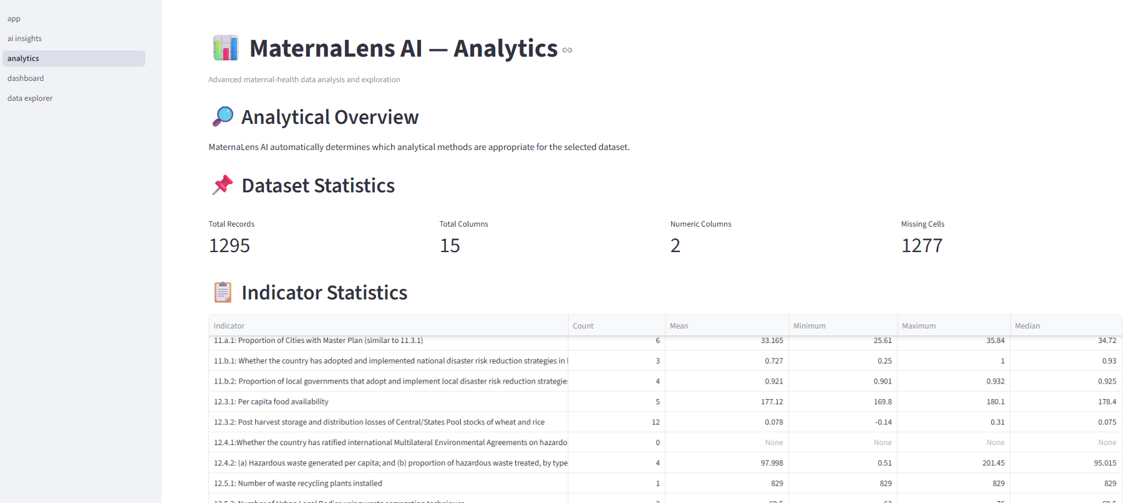
Analytics Page
·
·
·

Slide 15
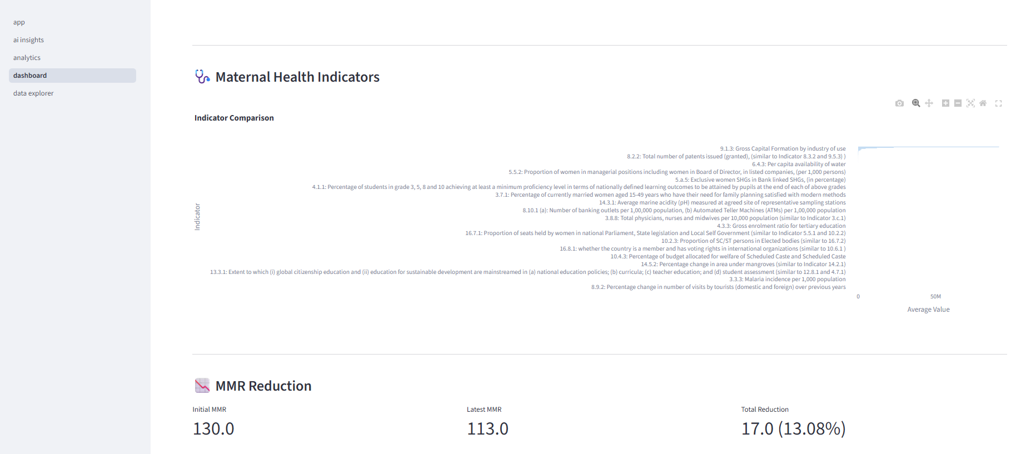
DashBoard Page
·
·
·

Slide 16
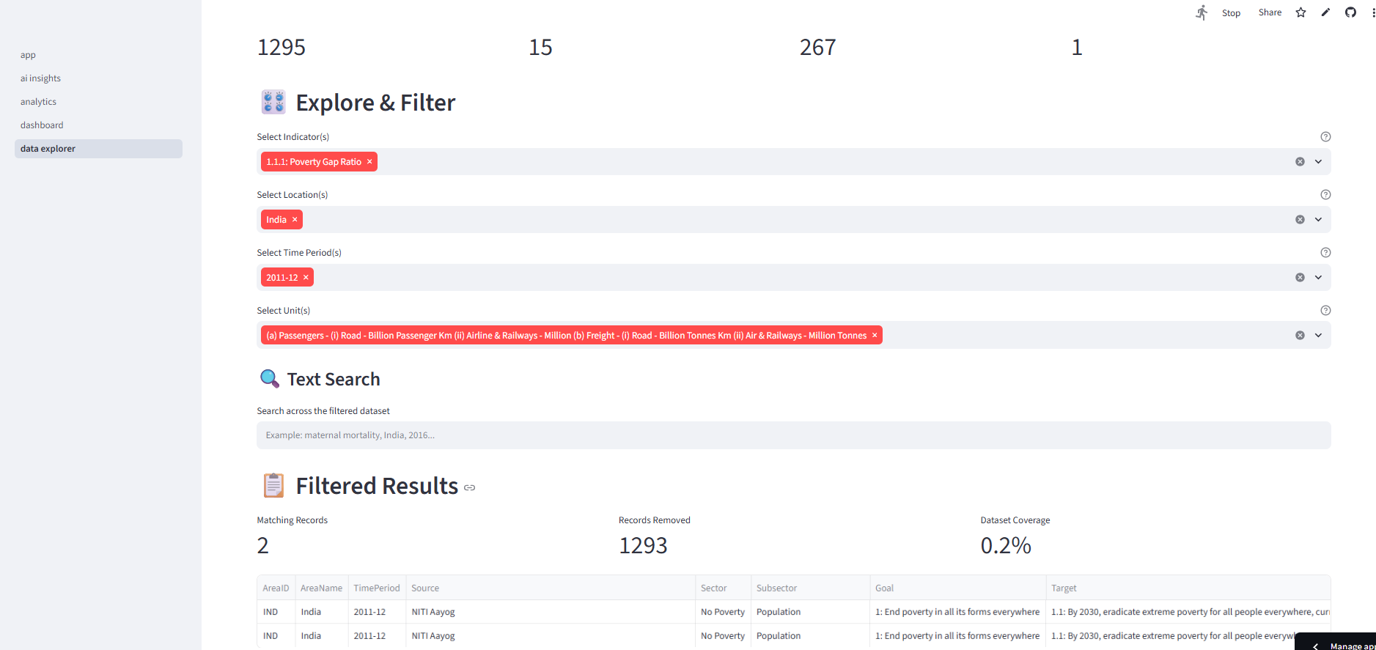
Data Explorer page
·
·
·

Slide 17
Git Hub Link
Public GitHub Repository: MaternaLens-AI
Working URL: https://github.com/GDAMPraveen/MaternaLens-AI
Streamlit Deployed: MaternaLens AI · Streamlit
Repository contains:
app.json
Mentarnal AI kosha Problem Statement.pdf
Mentarnal AI kosha.pptx
Source code, dataset, notebooks, utilities, README & requirements
Repository Status: Public & Accessible
·
·
·

Slide 18
Future Scope
1.Multi-Country and Multi-Year Data Integration – The system can be extended to include maternal-health datasets from multiple countries and a wider range of years. This will enable MaternaLens AI to perform geographic comparisons, identify differences in maternal mortality and healthcare indicators, and provide a broader assessment of progress toward SDG 3.1.
2. Advanced Predictive Analytics & Forecasting – Future versions can incorporate forecasting and predictive analytics to study maternal mortality trends and estimate future progress toward the SDG 3.1 target. This can help identify potential gaps early and support more informed maternal-health planning and decision-making.
3. Expanded Maternal-Health Indicators – The platform can be enhanced by incorporating additional indicators such as adolescent birth rates, healthcare expenditure, and other maternal-health measures. This will provide a more comprehensive view of the factors associated with maternal-health progress.
4. Advanced AI and Agentic Workflows – Future development can introduce more advanced agentic workflows and automated analysis agents to handle different stages of the data-analysis process. These agents could support automated dataset understanding, analytical selection, insight generation, and improved natural-language interaction.
5. Natural-Language Chart Generation – MaternaLens AI can be further enhanced to generate relevant charts and visualizations directly from natural-language questions. This would allow users to ask questions about maternal-health data and receive both analytical answers and appropriate visual representations.
6. Enhanced Geographic Visualization – With the integration of multiple geographic locations, future versions can include maps and interactive geographic visualizations. This can help users compare maternal-health indicators across countries or regions and identify areas requiring greater attention.
7. Integration of Additional IBM Foundation Models – The system can be extended to support additional IBM foundation models through IBM watsonx.ai when suitable model endpoints are available. This can provide greater flexibility in AI-powered interpretation, natural-language Q&A, and future intelligent analytical workflows.
·
·
·

Slide 19
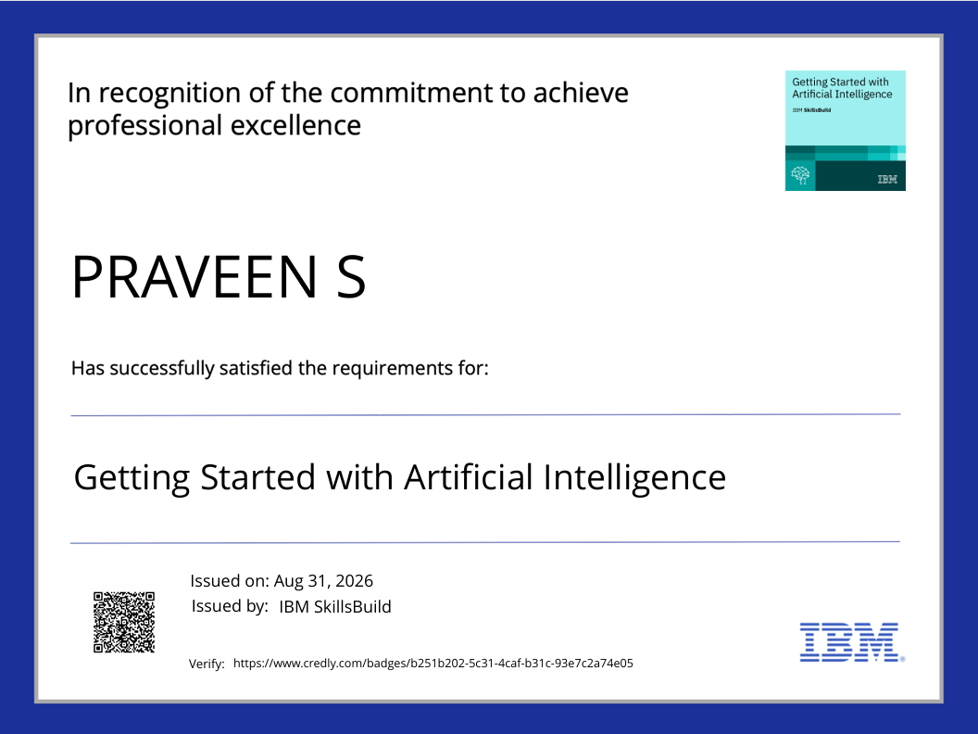
Certificates Earned:

Slide 20

Certificates Earned:​

Slide 21


